Slide 1
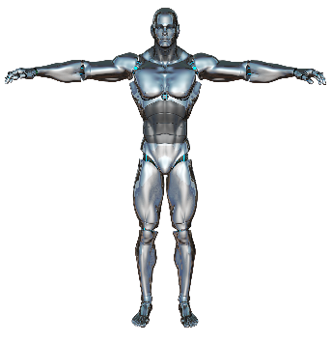
HorizonBit
Battlebot --iRobo

Slide 2
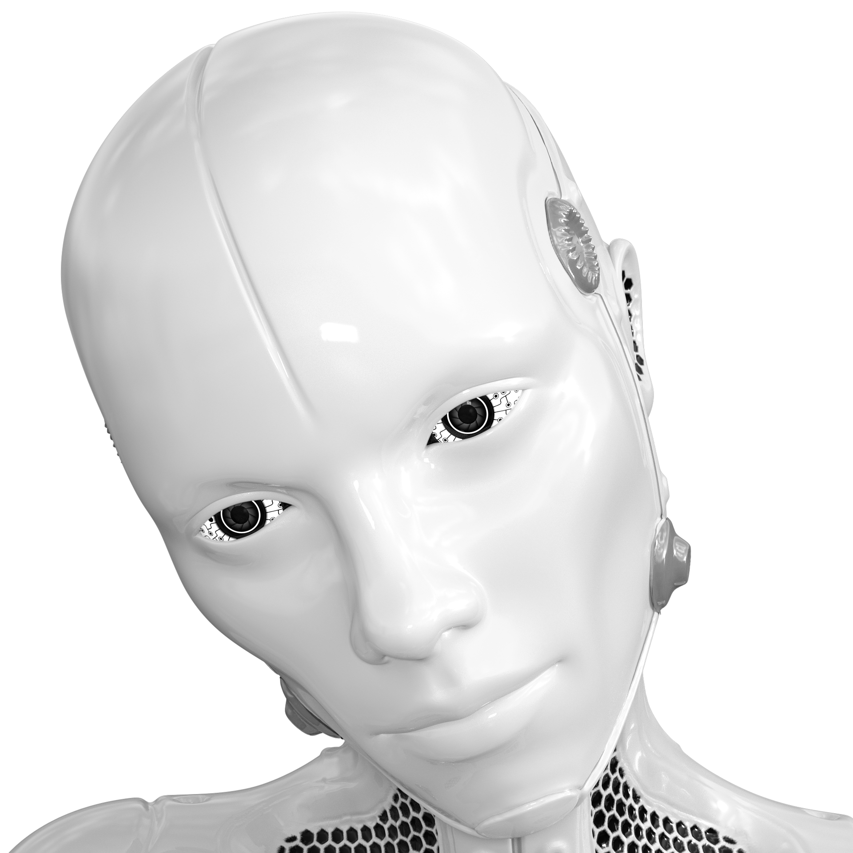
Group Members
MD Jewel(162-15-8071)
Ismail Hossain (162-15-7838)
Tamanna Himu (161-15-654)
Roushanara Pervin (182-)
Mehjabin Shila(162-15-)

Slide 3
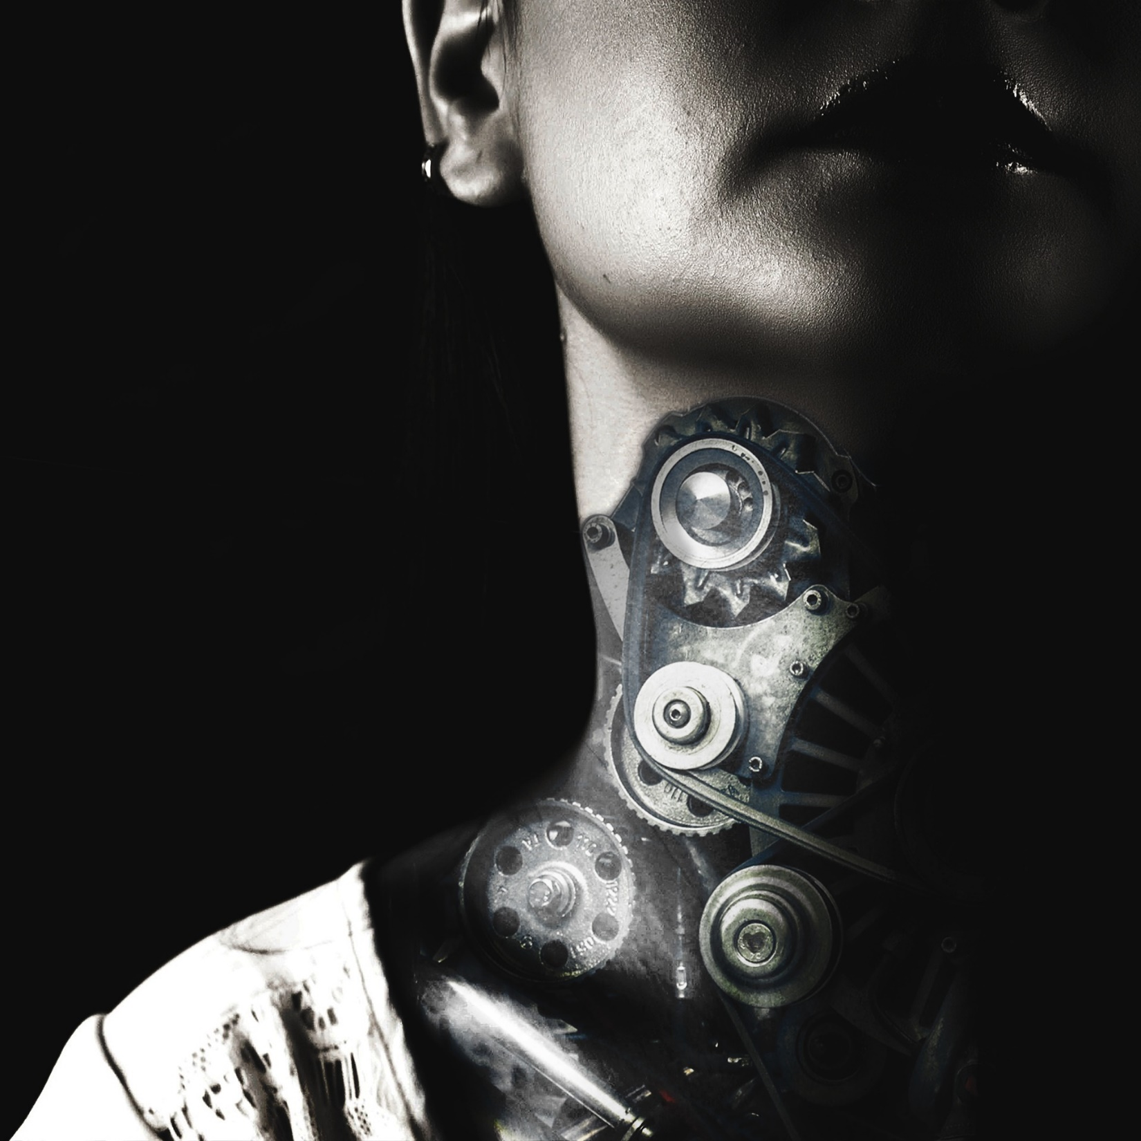
Bot Components
Arduino UNO
HC-05 Bluetooth Module
Motors 400 rpm (1x2)
L298n –Motor Driver (1x1)
Jumper wires
Bread Board
Battery 12v
Wheels (1x2)
Round wheel (1x1)
Nuts and Bolts
Body of the Bot
Etc.

Slide 4
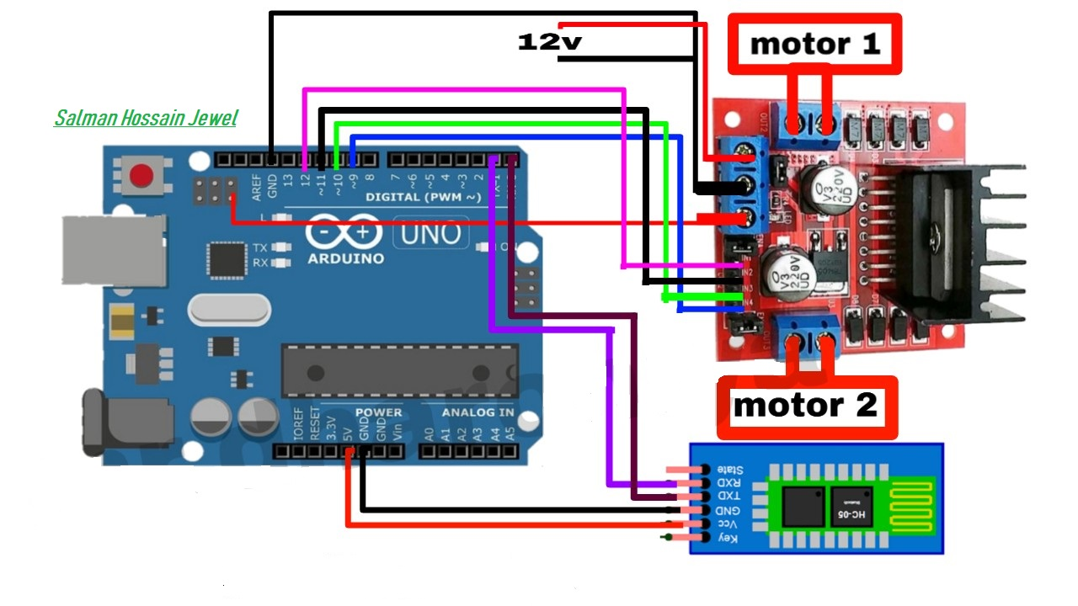
Circuit Diagram

Slide 5
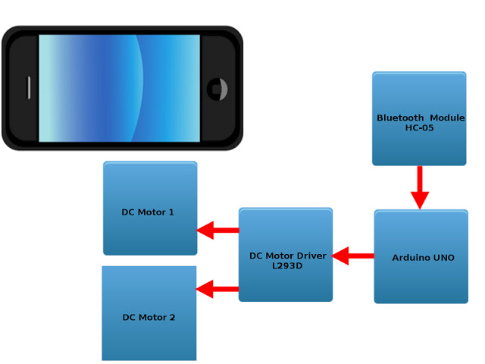
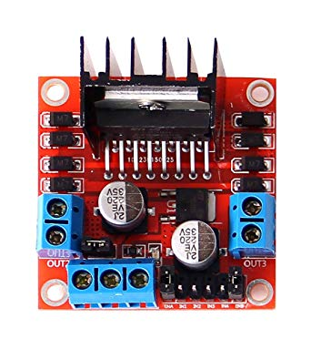
Over View

Slide 6
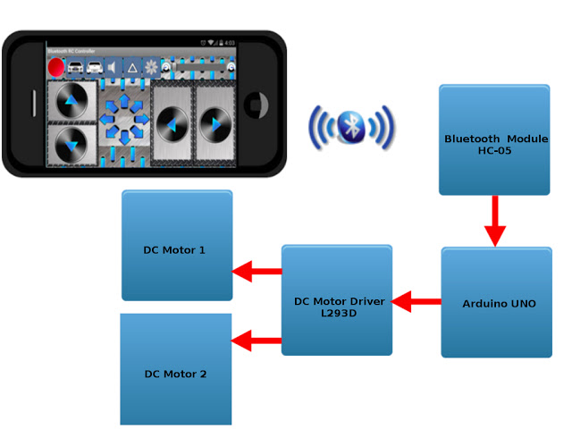
Connection Over Bluetooth

Slide 7
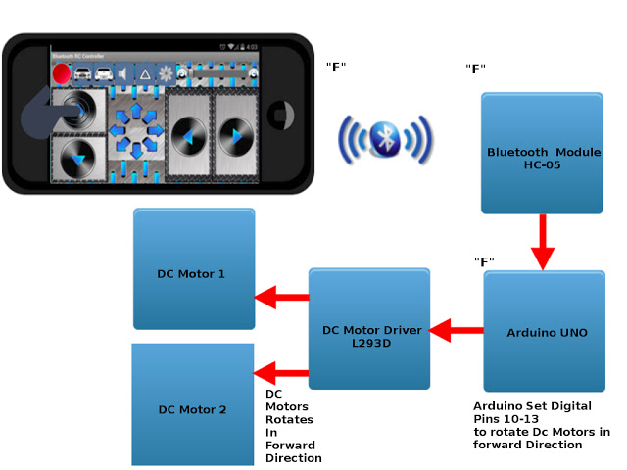
Sample Signal Passing
if( rcv == 'F') // Forward
{
digitalWrite(m1a, HIGH);
digitalWrite(m1b, LOW);
digitalWrite(m2a, HIGH);
digitalWrite(m2b, LOW);
}

Slide 8
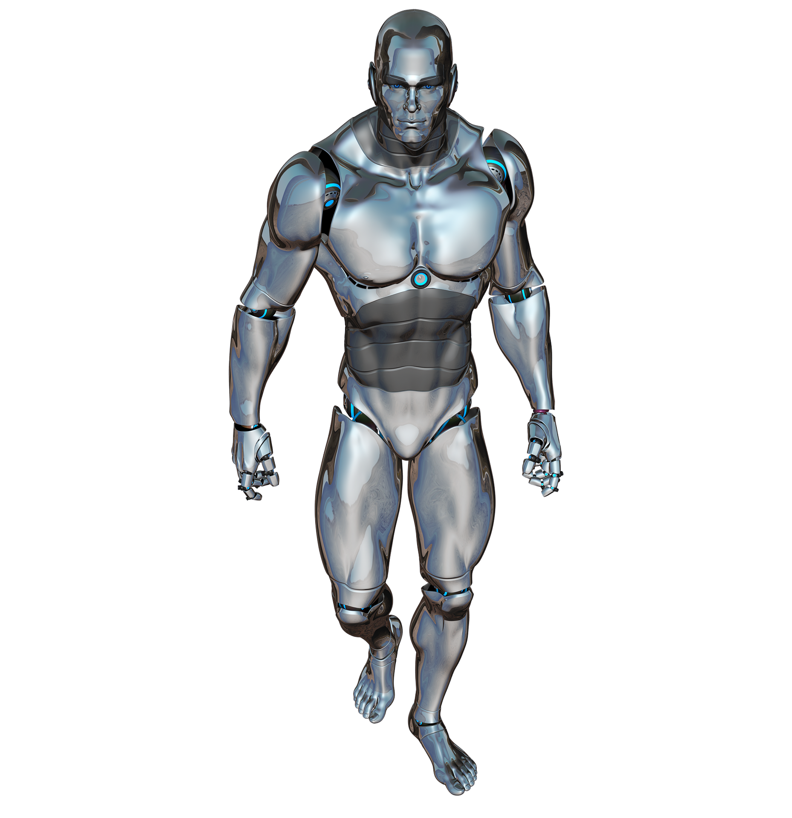
“
Difficulties
Heavy Body and Less motors
Direction
”

Slide 9
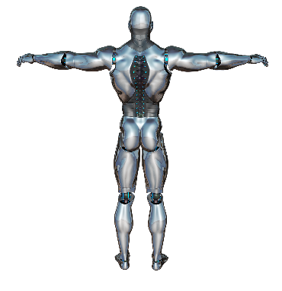
CHAPTER
BYE
THANKYOU

